Slide 1

Climate change litigation
Dr Joana Setzer
Grantham Research Institute on Climate Change and the Environment
London School of Economics

Slide 2
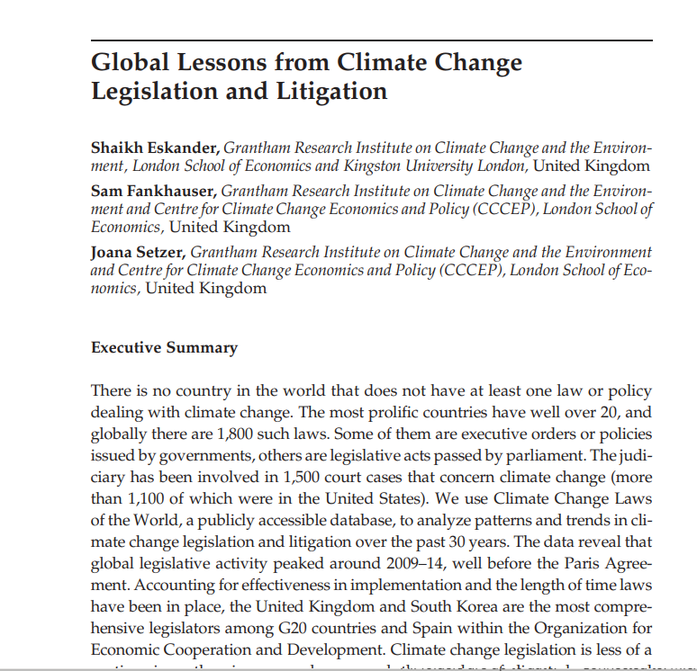
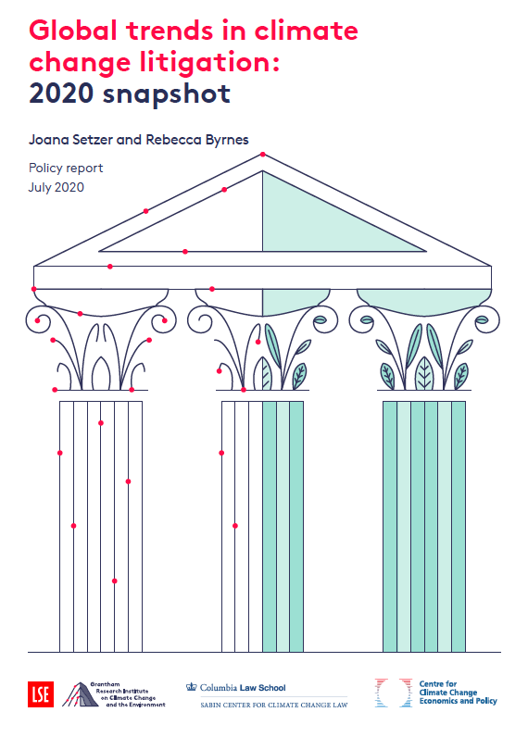
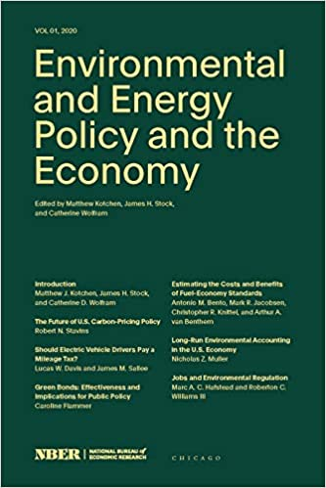
Outline
1) The Climate Change Laws of the World database
History, scope and content
2) Insights from the data
Legislation and litigation
Setzer & Byrnes (2020)
Eskander, Fankhauser & Setzer (2020)

Slide 3
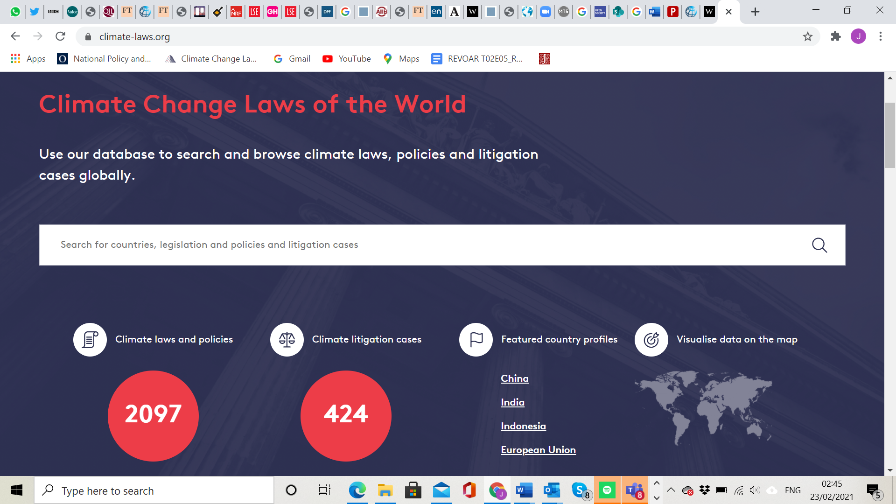
Climate Change Laws of the World in a nutshell
Searchable, publicly available database available on https://climate-laws.org/
Multi-year data collection exercise at the Grantham Research Institute, dating back to 2011
Collaboration:
Global Legislators Organisation for a Balanced Environment (GLOBE)
Inter-Parliamentary Union (IPU)
Sabin Center for Climate Change Law at Columbia Law School

Slide 4
Broad definition of climate change legislation and litigation
Climate change legislation
All measures relevant to the climate debate, eg carbon pricing, energy, transport, land use, adaptation
Both legislative acts passed by parliaments and executive orders by governments
Only national laws
Climate change litigation
Cases raise issues of law or fact regarding climate change
Case files contain keywords such as climate change, global warming, GHGs, sea level rise.
Local, regional, national and international

Slide 5
Global coverage (with gaps on litigation)
2,097 laws in 198 jurisdictions* Over 1,700 court cases*
* 197 countries and the European Union as a block
* 1,337 US cases in a separate database

Slide 6
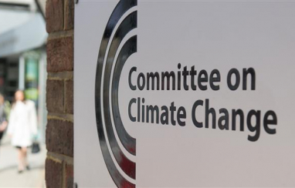
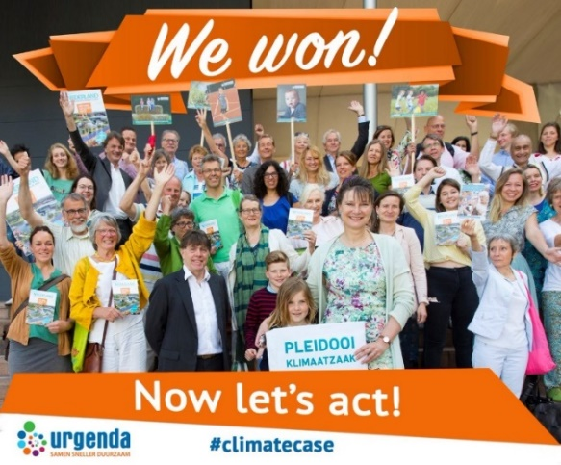
Including laws and court cases of strategic importance
Framework Legislation Strategic court cases
Overarching laws that define the institutional arrangements and objectives of climate policy
High-profile claims that seek increased mitigation ambition or compensation for damages caused

Slide 7

Including laws and court cases of strategic importance
Framework Legislation Strategic court cases
Example: UK Climate Change Act 2008
Defines long-term ambition; sets intermediate targets; creates new institutions; requires adaptation planning; defines processes and responsibilities
Overarching laws that define the institutional arrangements and objectives of climate policy
High-profile claims that seek increased mitigation ambition or compensation for damages caused

Slide 8

Including laws and court cases of strategic importance
Framework Legislation Strategic court cases
Example: Urgenda vs the Netherlands
Dutch NGO argues successfully for the adoption of stricter emissions targets on human rights grounds. Ruling upheld by the Dutch Supreme Court in 2019
Overarching laws that define the institutional arrangements and objectives of climate policy
High-profile claims that seek increased mitigation ambition or compensation for damages caused

Slide 9
Climate legislation peaked before the Paris Agreement
Climate legislation took off in the 1990s
35 climate related laws in 1990, many with broader purposes, e.g. energy efficiency
Legislative activity peaked in 2008-13
Many industrialized countries passed framework laws in this period
Developing countries start issuing laws (often executive orders)
Since the Paris Agreement
strengthening existing laws as important as passing new laws

Slide 10
Spain, UK and S Korea are the most comprehensive legislators
Brazil (28), Italy (24) and Indonesia (22) are the G20 countries with most climate laws. Spain (38) has most laws in the OECD.
Implementation matters, and “Rule of Law” indicators* can serve as a proxy of how well laws are put into practice.
Adjusting for implementation and the time laws were passed, Spain, the UK and South Korea are the most comprehensive legislators
* From Worldwide Governance Indicators
 | Number of laws | Quality-adjusted law years
Top 5 G20 legislators | BRA ITA IDN KOR GBR | GBR KOR ITA DEU AUS
Top 5 OECD / EU legislators | ESP CHL ITA KOR GBR | ESP GBR KOR NOR ITA

Slide 11
Climate legislation is not a partisan issue
In many Anglophone countries climate change is highly partisan, with significant rightwing opposition
However, globally there is a high degree of bipartisanship
Executive orders issued outside the OECD / EU group is the only case where right-wing parties act significantly less often
The chart shows, for each OECD/EU country, the share of climate laws passed under different political parties, relative to their time in power
Scores greater than 1 (distributions skewed to the right) indicate an above average inclination to legislate

Slide 12
Climate legislation slows during economic downturns
Interest in the environment wanes during recessions.
The share of laws passed during economic slowdowns is lower than the time the economy was slow
This has implications for climate action during the Covid 19 recovery
The chart shows, for each OECD/EU country, the share of climate laws passed during economic slowdowns, relative to the time this was the case. Scores less than 1 (distributions skewed to the left) indicate an aversion to pass climate laws in difficult times

Slide 13
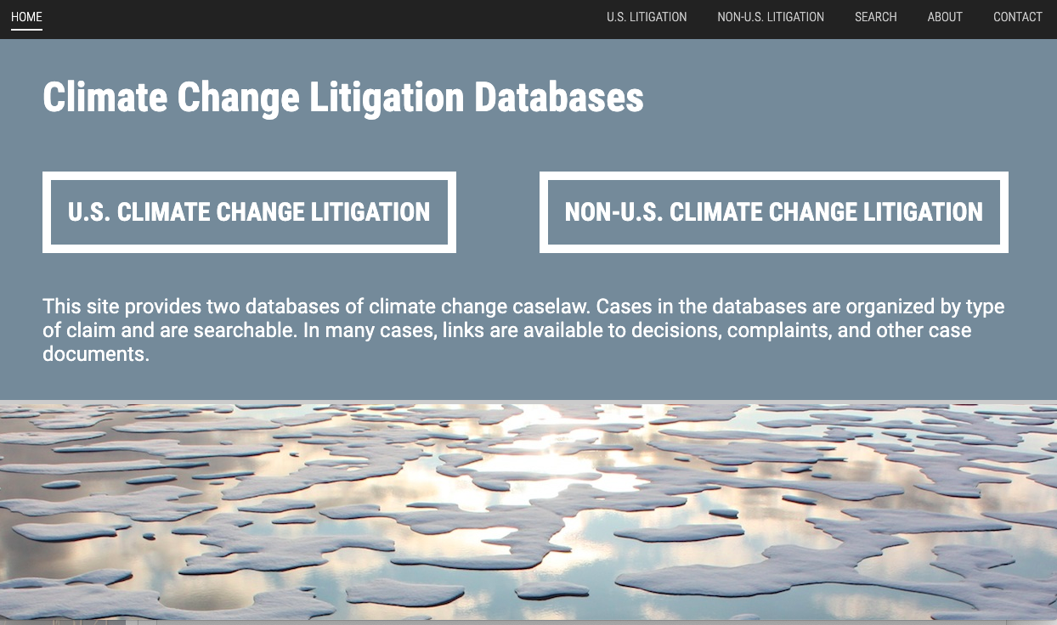
Total recorded climate change litigation cases (1986 – 2020)
Source: CCLW and Sabin Center data

Slide 14
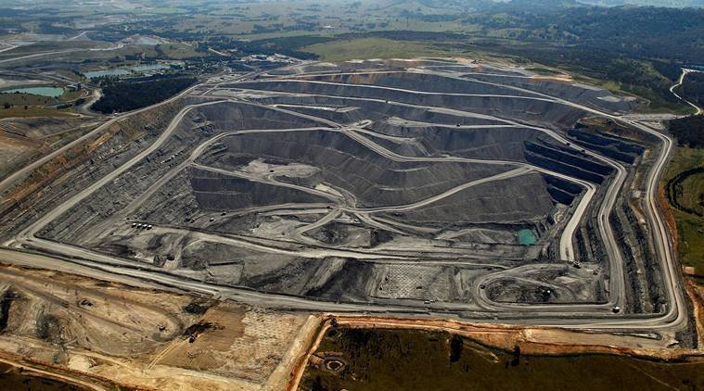
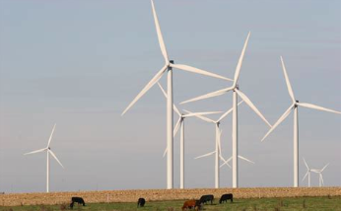
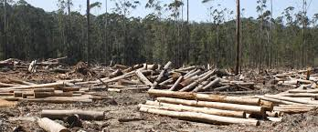
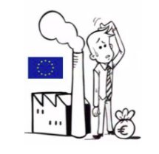
A heterogeneous group of cases
Notes:
The term ‘climate [change] litigation’ covers a wide variety of cases.
Some of the cases are designed to reach outcomes that go beyond the individual litigant bringing the case. These cases seek to advance climate policies, drive behavioural shifts by key actors, and/or create awareness and encourage public debate. Litigants bringing such cases make strategic decisions about who will bring the case, where and when the case will be filed, and what legal remedy will be sought. These cases are sometimes referred to as cases of ‘strategic litigation’ (see Ramsden and Gledhill, 2019, The Public Law Project and the European Commission on Human Rights for definitions of strategic litigation – though not specific to climate). There has been a growing interest in recent years from scholars, activists and practitioners in this type of litigation to address climate change (see Setzer and Vanhala, 2019; Peel and Osofsky, 2020).
The term climate litigation also includes civil and administrative procedures brought in the pursuit of private interests, which might not involve activist intent (Bouwer, 2018), such as litigation seeking to uphold planning approvals or to clarify reporting requirements under an emissions trading system.
While it is difficult to establish a clear distinction between strategic cases and other forms of climate litigation, it is useful to keep in mind that not all consists of legal action seeking to bring social change and/or to impact society and law beyond the individual case.

Slide 15

Scope
Mere mention of “climate change” is not enough
What to exclude?
Not all air quality or renewable energy siting or contracting disputes are climate-related
Adaptation and disaster recovery overlap in part
Sufficient condition for inclusion
court-cited fact related to climate change
legal obligation based on changing climate

Slide 16
Climate litigation: Pro and anti – U.S.
Outcomes of 721 cases between 1990-2016: anti favoured pro-regulatory, with a ratio of 1.4:1 (McCormick, 2018)
Drivers of 159 cases filed between 2017-2018 (first 2 years of the Trump Administration): lawsuits advancing climate protections exceeded those opposing, with a ratio of 4:1 (Adler, 2019)
Notes:
The US provides a clear illustration of how litigation can favour or counter climate action, and also how this might vary over time.
McCormick 2018: Created a database of all the domestic climate change lawsuits from 1990 through 2016. Of 721 cases reviewed, there were more outcomes that favoured antiregulatory (n = 309) compared to proregulatory positions (n = 224), with a ratio of about 1.4 to 1. When examined by climate topic, cases that involve air quality cases followed this pattern. However, for the relatively small number of energy efficiency and renewable energy cases, outcomes more often favoured proregulatory positions, by a ratio of 2.6 to 1. In biodiversity cases, antiregulatory litigants won biodiversity cases at about the same rate as proregulatory litigants.
Adler (2019): categorizes and reviews 159 climate change cases filed during 2017 and 2018 to shed light on how litigation is counterbalancing—and at times complementing—the Trump Administration’s efforts to undermine climate change protections. The cases were sorted into five categories:
Defending Obama Administration Climate Change Policies & Decisions;
Demanding Transparency & Scientific Integrity from the Trump Administration;
Integrating Consideration of Climate Change into Environmental Review & Permitting;
Advancing or Enforcing Additional Climate Protections through the Courts; and
Deregulating Climate Change, Undermining Climate Protections, or Targeting Climate Protection Supporters.
The first four categories are “pro” climate protection cases—if their plaintiffs or petitioners are successful they will uphold or advance climate change protections. The fifth category contains “con” cases—if their filing party or parties are successful, these cases will undermine climate protections or support climate policy deregulation. 129 of the reviewed cases were “pro” climate protection and 30 were “con.” The pro cases outweigh the con cases roughly 4:1.

Slide 17
Outcomes ‘favourable’ and ‘unfavourable’ to climate change action
Outside of the US, judges appear more inclined to support climate action.
(Eskhander, Fankhauser & Setzer, 2020)
Outcomes of Non-US litigation, April 1994 – May 2020

Slide 18
Challenges
Jurisdiction
Standing
Separation of powers
Notes:
Justiciability refers in general to a person’s ability to claim a remedy before a judicial body when a violation of a right has either occurred or is likely to occur. The term implies access to appropriate mechanisms to protect recognized rights.
A case is said to be justiciable in a particular forum if that forum both is capable of deciding the matter and considers it appropriate to do so. The justiciability analysis entails both legal and prudential questions. First is the question of whether the court is legally empowered to adjudicate the case – this typically depends on the constitutional grant of authority to the court. Second is the question of whether it would be imprudent for the court to adjudicate the case – the court typically has discretion to determine this matter based on the facts before it. The doctrine of justiciability varies by jurisdiction.
Jurisdiction: Generally not an issue, except in common law/nuisance/tort actions
Standing:
The legal definition of “standing,” or locus standi, varies among countries, and may be more or less open or restrictive depending on which country and legal system (civil or common law) one is operating in. In essence, the term refers to the criteria one must satisfy in order to be a party to a legal proceeding. These criteria are typically aimed at ensuring that the parties have a sufficient stake in the outcome of the case and that the claims brought by the parties are capable of judicial resolution.
Interesting cases so far: MA V EPA (YES FOR STATES); COMER V MURPHY OIL (NO FOR PRIVATE PARTIES FOR CONSPIRACY); URGENDA (ORG STANDING BUT NOT INDIVIDUALS FOR PRACTICAL REASONS);
Courts in Global South have not yet addressed this issue closely
Separation of Powers:
The principle of separation or balance of powers dictates that one branch of government cannot exceed the authority granted to it by the constitution or other laws and intrude on the authority of another branch. While this doctrine is typically evoked as a matter of constitutional law, it also applies in non-constitutional systems to the extent that there are policies, laws and regulations outlining the respective powers of each branch of government. The underlying question here is whether the courts are the appropriate forum to hear and resolve questions of equity, rights, and obligations in regards to climate change.
Major issue in some jurisdictions, and relates to theory of case, remedy sought.
Notably, there are other climate change cases involving the protection of constitutional and human rights where courts have exercised jurisdiction over rights-related disputes without even discussing the separation of powers doctrine, presumably because there is no dispute that such disputes fall within the courts’ domain. These cases include cases from Pakistan, India and Nigeria.

Slide 19
Climate litigation risk is being amplified by a number of factors
Increased physical and transition risk
Increasing awareness of the climate crisis
Rising climate commitments by governments, corporates and investors
Increasing availability of litigation funding
Evolving legal duties
Jurisprudential developments in the evolving field of climate change attribution science
Implications of COVID-19 on economic recovery and climate-related actions

Slide 20
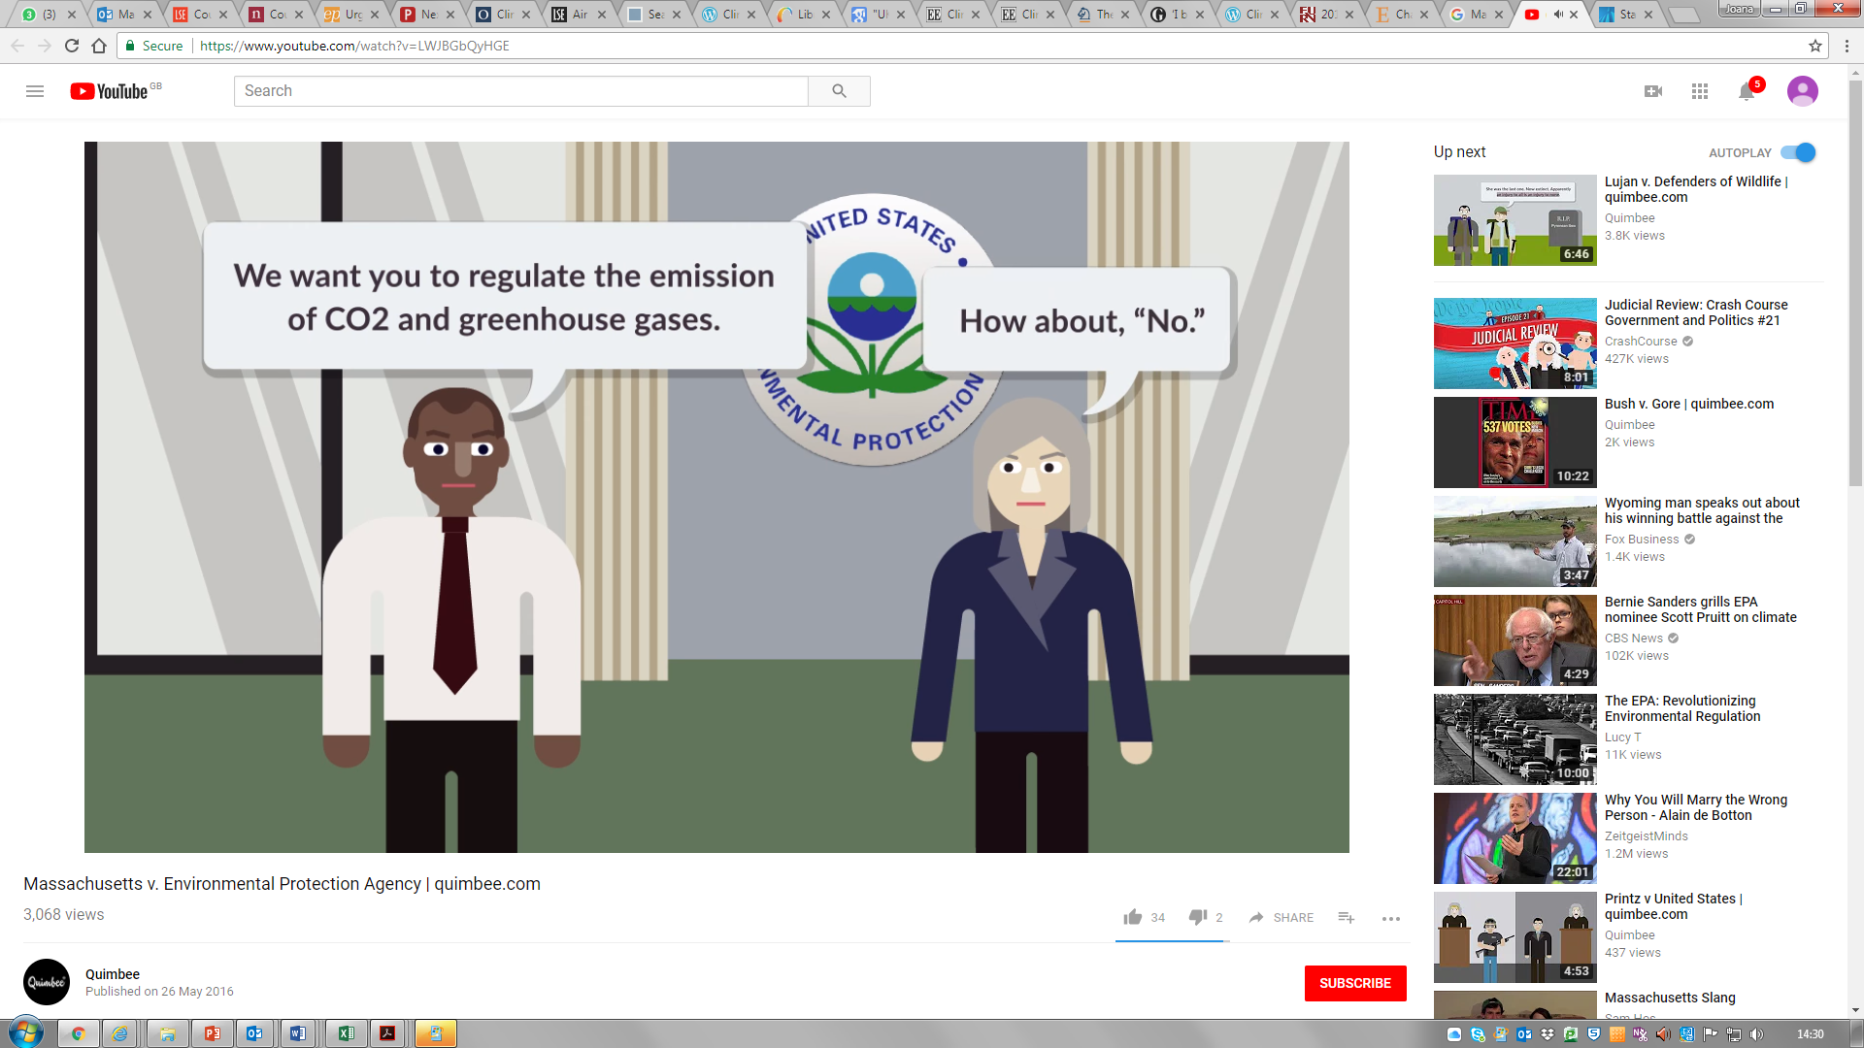
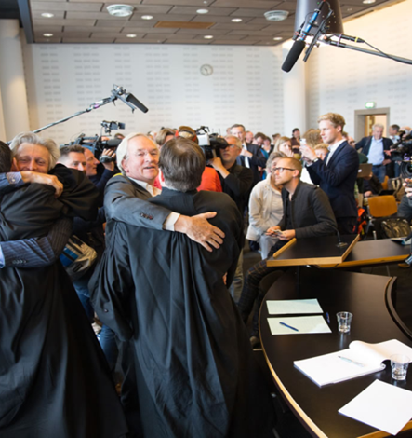
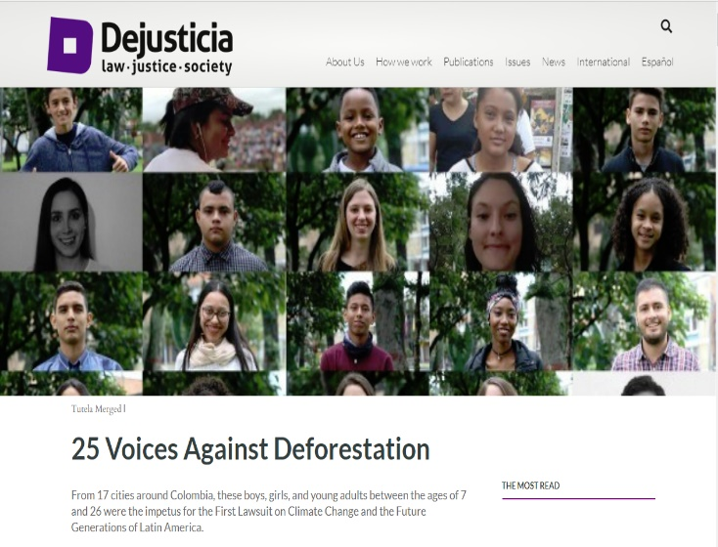

Against governments
Pre-2015
Post-2015
Notes:
Garavito: Prior to 2015, only five rights-based climate cases had been filed anywhere in the world.
Between 2015 and early 2020, litigants brought 34 suits against states (and, to a much lesser extent, corporations) for human rights violations related to climate change in twenty-one national jurisdictions and in two regional and three global judicial or quasi-judicial bodies
Urgenda, a Dutch NGO, and nine hundred co-plaintiffs who were asking the Dutch government to adopt more stringent climate policies. The government appealed, in 2018 the Court of Appeals upheld the 2015 ground-breaking decision. The government appealed again to the Supreme Court, and in December 2019 the Supreme Court of the Netherlands ordered the Dutch government that it must urgently & significantly reduce emissions to protect human rights.
Juliana v. US (aka “Our Childrens’ Trust” lawsuit) – lawsuit against the U.S. federal government for policies supporting fossil fuel use and for lack of policies to combat climate change.
Plaintiffs alleging violation of substantive due process and the public trust doctrine.
Survived motion to dismiss at district court level and *may* go to trial (but this has been appealed to the 9th Circuit)

Slide 21
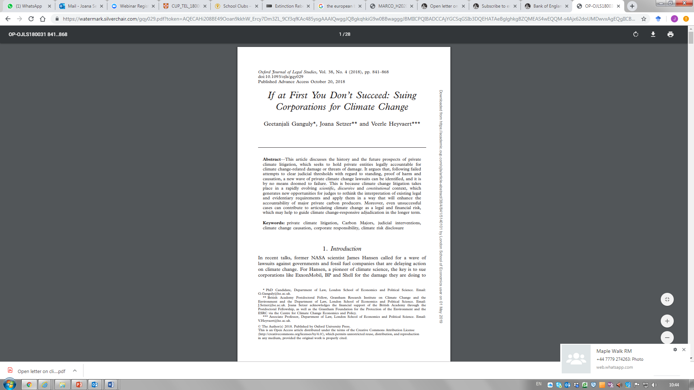
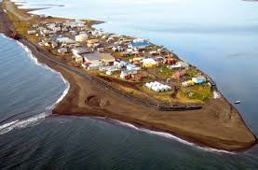
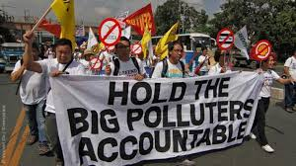
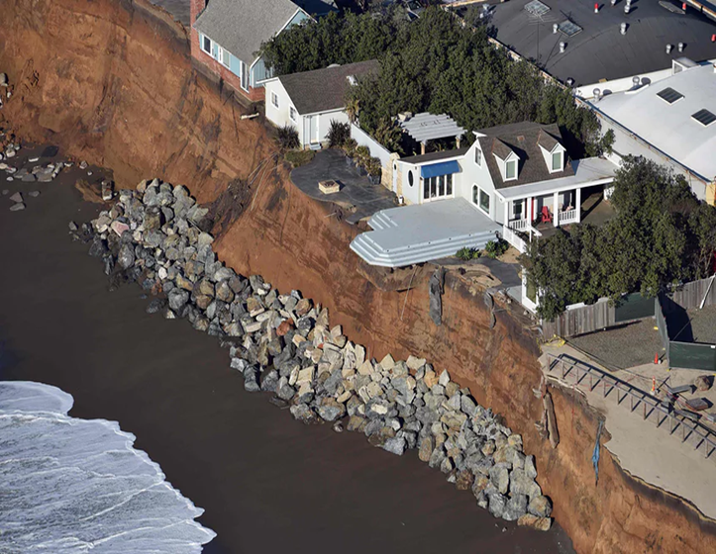


Against corporations
Pre-2015
Post-2015

Slide 22
Against major carbon emitters
Numbers of cases against the Carbon Majors, 2005–2020

Slide 23
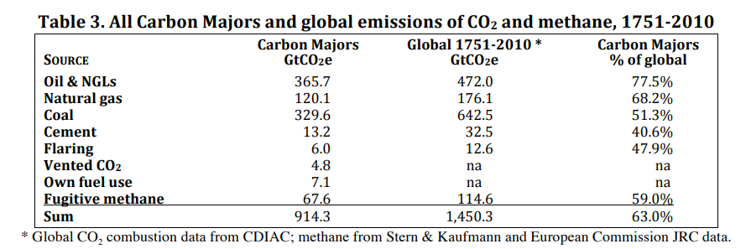
Source Attribution Research Richard Heede, Carbon Majors Report (2014)

Slide 24
CLIMATE-RELATED IMPACTS RAISED IN COMPLAINTS
 | Sea level rise | Hydrologic Cycle | Public Health | Other
San Mateo, Marin, Imperial Beach | ✔
San Francisco, Oakland | ✔
Santa Cruzes, Richmond (CA) | ✔ | ✔ | ✔ | ✔
New York City | ✔ | ✔
Colorado |  | ✔ |  | ✔
King County | ✔ | ✔ | ✔ | ✔
Rhode Island | ✔ | ✔
Baltimore | ✔ | ✔ | ✔

Slide 25
New Wave of U.S. Litigation
Quantifying “responsibility” for climate change
Contribution to emissions impact – e.g., share of emissions generated from fossil fuels produced by defendant company
Where do we impose “responsibility” in the fossil fuel supply chain? On fossil fuel producers? Power plant owners? Energy consumers?
Plaintiffs go beyond emissions attribution in seeking to establish responsibility and wrongful conduct, alleging that the defendant companies are:
Profiting from activities that contribute to climate change
Intentional obfuscation of climate science
Lobbying to prevent action on climate change
Notes:
Linking impacts to emitters is more challenging than linking impacts to anthropogenic climate change. Such attribution involves identifying, with relative confidence, the proportional contribution of the company’s fossil fuels to changes in global atmospheric composition, extrapolating the proportional contribution to more localized impacts such as sea level rise, and then identifying actual damages (e.g., physical damage to infrastructure) that were caused by those impacts (as opposed to the negligence of other actors). Further complicating this inquiry is the fact that “responsibility” is not a purely scientific concept: Even if scientists can attribute specific damages to emissions from fossil fuels produced by a specific company, there are still questions about how responsibility should be allocated between the company that produced the fuels, the end users of those fuels (e.g., electric utility companies, people driving cars), and other actors involved in the fossil fuel supply and consumption chain

Slide 26


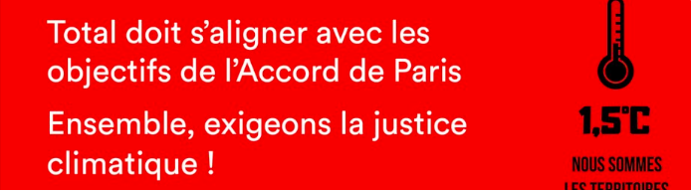
Litigation against Energy Companies Outside US
Cases seeking Damages
Lliwuya v. RwE (Germany)
Cases seeking Transformation to a 1.5 Pathway
Notre Affaires a Tous v. Total (France)
Milieudefensie et al. v. Royal Dutch Shell plc. (Netherlands)
Notes:
Linking impacts to emitters is more challenging than linking impacts to anthropogenic climate change. Such attribution involves identifying, with relative confidence, the proportional contribution of the company’s fossil fuels to changes in global atmospheric composition, extrapolating the proportional contribution to more localized impacts such as sea level rise, and then identifying actual damages (e.g., physical damage to infrastructure) that were caused by those impacts (as opposed to the negligence of other actors). Further complicating this inquiry is the fact that “responsibility” is not a purely scientific concept: Even if scientists can attribute specific damages to emissions from fossil fuels produced by a specific company, there are still questions about how responsibility should be allocated between the company that produced the fuels, the end users of those fuels (e.g., electric utility companies, people driving cars), and other actors involved in the fossil fuel supply and consumption chain

Slide 27
Corporate Disclosure-Related Litigation Risk
People of the State of New York v. ExxonMobil (NY)
Commonwealth of Massachusetts v. ExxonMobil (MA)
Ramirez v. ExxonMobil (TX)
Abrahams v. Commonwealth Bank of Australia (AUS)
ClientEarth v. Enea (Poland)
Complaint against BP, violations of the OECD Guidelines (UK)

Slide 28
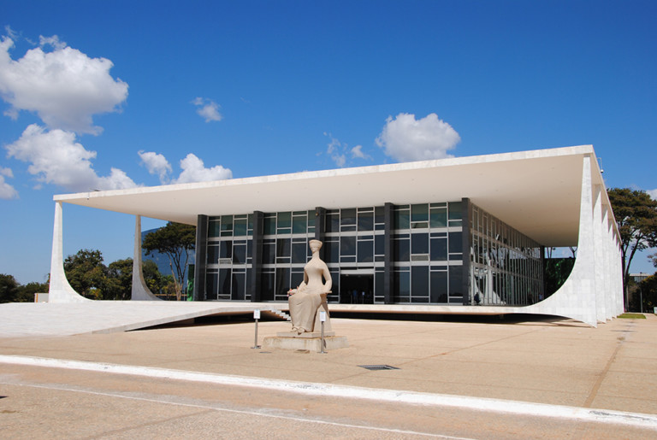
Climate litigation in the Global South
Poor enforcement of existing legislation, rights-based, linked with other environmental problems
Earthlife Africa Johannesburg v Minister of Environmental Affairs & Others)
Asghar Leghari v. Federation of Pakistan
Political parties v Brazil

Slide 29
Climate change litigation and COVID-19
Maybe
- Decrease in new filings
- Slower pace of ongoing litigation
But maybe new grounds for cases
linking the two emergencies
challenge bailouts and avert deregulation

